Slide 1
Representing Syntax and Semantics

Slide 2
Formal Language Theory
Language – the set of all legal sentences generated by a grammar
Early work on formal representations of grammars was for computerized natural language understanding and processing. Such representations are not adequate by themselves for languages such as English.
However, formal grammars are useful for the carefully defined, constrained languages used in computer programming.
Goal of formal language theory - to develop a set of tools to define exactly what the set of legal programs is for a programming language.
Programming languages are defined in terms of grammars

Slide 3
Grammars
A grammar is defined as:
    G(S,N,T,P) where
S = the starting non-terminal
  SENTENCE
N = set of non-terminals
  {SENTENCE, SUBJECT, PREDICATE, NOUN-PHRASE, DIRECT-OBJECT, ARTICLE, NOUN, VERB, ADJECTIVE}
T = set of terminals
  {the, a, man, apple, big, little, people}
P = set of production or rewrite rules
  {<SENTENCE>::=<SUBJECT><PREDICATE>
  <SUBJECT> ::=<ARTICLE><NOUN>
  . . . }
Sentence - any string of terminals which can be derived from the starting nonterminal by repeated application of the rules
Nonterminals can only appear in partial derivations.

Slide 4
Example Grammar
1. <SENTENCE> ::=<SUBJECT><PREDICATE>
2. <SUBJECT> ::=<NOUN-PHRASE>
3. <NOUN-PHRASE> ::=<ARTICLE><NOUN>
4. <PREDICATE> ::=<VERB><DIR-OBJ>
5. <DIR-OBJ> ::=<ARTICLE><NOUN>
6. <ARTICLE> ::= the
7. <NOUN> ::= man
8. <NOUN> ::= apple
9. <VERB> ::= eats
10.<VERB> ::= sees
A legal sentence:
  the man eats the apple

Slide 5
Chomsky Hierarchy
Noam Chomsky did pioneering work in formal representations of languages.
The Chomsky Hierarchy is a classification of grammars based on constraints on the form of their rules (productions)
The Hierarchy:
  Type 0: Unrestricted grammars
  Type 1: Context Sensitive grammars
  Type 2: Context Free grammars
  Type 3: Regular grammars

Slide 6
Automata theory
There are several classes of theoretical machines called automata:
  Finite State Automata (FSA)
    Represent regular grammars
    Used for lexical analysis
  Pushdown Automata (PDA)
    Represent context free grammars
    Used for syntactic analysis
  Linear Bounded Automata (LBA)
    Represent context sensitive grammars
    LBA in Wikipedia
  Turing Machines (TM)
    Represent unrestricted grammars

Slide 7
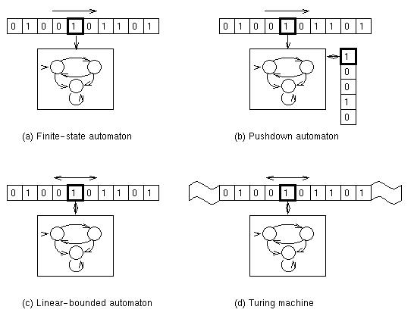
Abstract machine models
We will consider the power of finite and pushdown
automata to solve pattern recognition problems,
In particular, we will explore the types of symbol
patterns that can be recognized by these classes of
machines.

Slide 8
Type 3 – Regular Grammars
Constraints:
  Left hand side must contain a single nonterminal
  Right hand side must be a terminal or a terminal followed by a single nonterminal or an empty string
All productions are of the form N::= tM or N ::= t where N and M are nonterminals and t is a single terminal
Example:
    S -> dS
    S -> pF
    S -> d
    S -> dF
    F -> d
These grammars can recognize any number of patterns of finite length

Slide 9
Regular Grammars
Regular grammars and are useful for simple local parsing problems such as token recognition
<id> ::= <letter> | <letter><idtail>
<idtail> ::= <alnum><idtail> | ε
<int-cnst> ::= 0<int-cnst> | 1<int-cnst> | ... | 9<int-cnst> | 0 | 1 | ... | 9

Slide 10
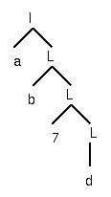
Regular Grammars
Identifiers:
I → a L | b L | c L |...| z L | a |...| z
L → 1 L | 2 L |...| 0 L |
1 | 2 |...| 0 |
a L | b L | c L |...| z L |
a | b |…| z
A parse tree:

Slide 11
Finite Automata
Finite Automata are able to recognize the symbol patterns which comprise the regular grammars.
Although finite automata and regular grammars are at the lowest level of the Chomsky hierarchy, they are of significant utility.
Example: Lexical analysis - does a given string in a computer program constitute a legal variable name?
State Transition Diagrams
  A finite collection of labeled circles connected by arrows that indicate directed arcs.
  One circle is designated with a pointer as the starting position (start state).
  One or more have double circles that indicate that a valid string has been recognized (accept state).

Slide 12
A Transition Diagram
letter
digit
letter
3
1
digit
2
A string is accepted if the symbols appearing in
the string correspond to a sequence of
labeled arcs that leads from the start state
to the accept state.
Examples: X25, 25

Slide 13
Another Example
letter or
digit
letter
3
:
=
1
4
5
digit
digit
2

Slide 14
Nondeterministic Finite Automata
digit
digit
2
.
1
3
digit
digit
digit
4
5
digit
A finite automaton that accepts strings
representing integers or floats with a decimal.

Slide 15
Finite Automata
1. Finite automata, although the least inclusive of the formal languages in the Chomsky hierarchy, have some very useful capabilities.
2. Deterministic and Non-deterministic finite automata are of equivalent computational power.
3. A language of the form:
{ x^{n}y^{n} : n ε N }
is not regular.
Suppose that:
x = “(“
and
y = “)”

Slide 16
Type 2-Context Free Grammars
Constraint:
  The left hand side of a production has one and only one symbol which is a nonterminal
  The RHS is unconstrained
Example:
    S -> zPzQz
    P -> xPx
    P -> Q
    Q -> yPy
    Q -> λ { a lambda rule}
Any context free grammar containing λ-rules can be converted to a context free language with no λ-rules.
These languages are implemented via stacks and can be used to build parse trees.

Slide 17
Pushdown Automata
Finite automata cannot recognize strings of the form:
{ x^{n}y^{n} : n ε N }
because they have no way to “remember” how many “x” characters they encountered to compare with the number of “y” characters they see.
Pushdown Automata have a stack upon which they can store information for later recall.
They also have the features of finite automata:- an input stream of characters, a control mechanism that can be in any of a finite number of states, a start state and at least one accept state.
The finite set of symbols that Pushdown Automata can store on the stack are known as stack symbols and constitute some or all of the machine’s alphabet.

Slide 18
Pushdown Automata
Transitions executed by pushdown automata are variations on this sequence:
  read a symbol
  pop a symbol from the stack
  push a symbol on the stack
  enter a new state
A notation for the process:
(p, x, s; q, y)
where:
p = the current state
x = the symbol that was read
s = the symbol that was popped from the stack
q = the new state to enter
y = the symbol that is pushed back on the stack.
the (;) indicates that the current state, input symbol and symbol on the top of the stack collectively determine the new state and the symbol to be pushed.

Slide 19
Finite and Pushdown Automata
Consider this special case of a pushdown automaton transition:
( p, x, λ; q, λ )
This transition ignores the stack. The activities of the machine depend on the current state and the current input symbol.

Slide 20
Pushdown Automata Example
The transition diagram can indicate the current state and the next state, so we will use the following triple:
( x, y; z ) where:
x = input symbol
y = item that is popped
z = item that is pushed
y, x; λ
x, λ; x
2
1
y, x; λ

Slide 21
Example (cont)
1. Mark stack with (#).
2. Read x, push x, return to state 1.
3. read x, push x, return to state 1.
4. Read y, pop x. goto state 2.
5. Read y, pop x, return to state 2 (an accept state) with an empty stack.

Slide 22
Pushdown automata
1. Deterministic pushdown automata DO NOT have the same capabilities as nondeterministic pushdown automata.
2. The Lookahead principle - peeking at future symbols without actually reading them in order to resolve nondeterminism in a state change.
LL(K) Parsers
There are a hierarchy of LL parsers which are distinguished by the number of input symbols they look ahead.
LL(1) parsers are a special case of LL(K) parsers that look ahead one symbol.
3. Pushdown automata are able to parse the context free grammars in the Chomsky hierarchy.
4. A standard, rule-based representation of programming language constructs is BNF - Backus-Naur Form.

Slide 23
NDPDA are more powerful than DPDA
Non-deterministic PDA have greater expressive capabilities than deterministic PDAs.
Consider the set of binary palindrome strings (reading the same forward and backward) generated by the grammar:
S → 0S0 | 1S1 | 2
We can recognize such strings by a deterministic PDA.
However, consider the following set of palindromes:
S → 0S0 | 1S1 | 0 | 1

Slide 24
Language Description - BNF
BNF (Backus Naur Form) In order to describe the syntax of Algol, BNF was invented. BNF provides a formal way of describing the legal constructs of any language that is sufficiently regular.
Components of BNF
  Terminals (the actual symbols)
  Nonterminals - that can be replaced by other nonterminals and terminals
Example - Specifying the syntax of an integer
<integer> ::= +<unsigned integer>
| -<unsigned integer>
| <unsigned integer>
<unsigned integer> ::= <digit>
| <unsigned integer><digit>

Slide 25
BNF Description of Numerics
<integer> ::= +<unsigned integer>
| -<unsigned integer>
| <unsigned integer>
<unsigned integer> ::= <digit>
| <unsigned integer><digit>
<decimal fraction>::= .<unsigned integer>
<exponent part>::= ₁₀<integer>
<decimal number>::=<unsigned integer>
| <decimal fraction>
| <unsigned integer><decimal fraction>
<unsigned number>::=<decimal number>
| <exponent part>
| <decimal number><exponent part>
<number>::= +<unsigned number>
| -<unsigned number>
| <unsigned number>
<digit>::= 1|2|3|4|5|6|7|8|9|0

Slide 26
A Simple Programming Language
<program>::= PROGRAM <decls>
  BEGIN <stmtlist> END.
<decls>::=<declaration>;<decls> | λ <declaration>::=CONST <id> = <constant>
  | VAR <id>:<type>
<stmtlist>::=<stmt>;<stmtlist> | λ <stmt>::= IF<exp> THEN <stmtlist>
  ELSE <stmtlist> END
  | WHILE <exp> DO <stmtlist> END
  | <id> := <exp>
<constant> ::= <integerconst>|<realconst>
<type>::= Integer | Real
<exp>::= <operand><exp tail>
<exp tail>::=<op><operand><exp tail>
  | λ
<operand>::= <id> | <constant>
<op>::= + | - | * | /
<id> ::= (like homework)
NOTE: use of recursion in <decls> and <stmntlist> to create repetition. Note use of empty (λ)

Slide 27
EBNF
EBNF (Extended Backus Naur Form) provides extensions to BNF to improve readability
  Permits zero or more (*) Kleene Star
  Permits one or more (+) Kleene Cross
  Optionally include [ ]
  Grouping - use an alternative {}
<integer> ::= <unsigned integer>
<unsigned integer> ::= <digit>⁺
<decimal number>::=
<unsigned integer>
[<unsigned integer>].<unsigned integer>
<number>::=
<decimal number>
[<decimal number>]₁₀<integer>
<digit>::= 1|2|3|4|5|6|7|8|9|0
[
]
+|-
{
}
[
]
{
}
+|-

Slide 28
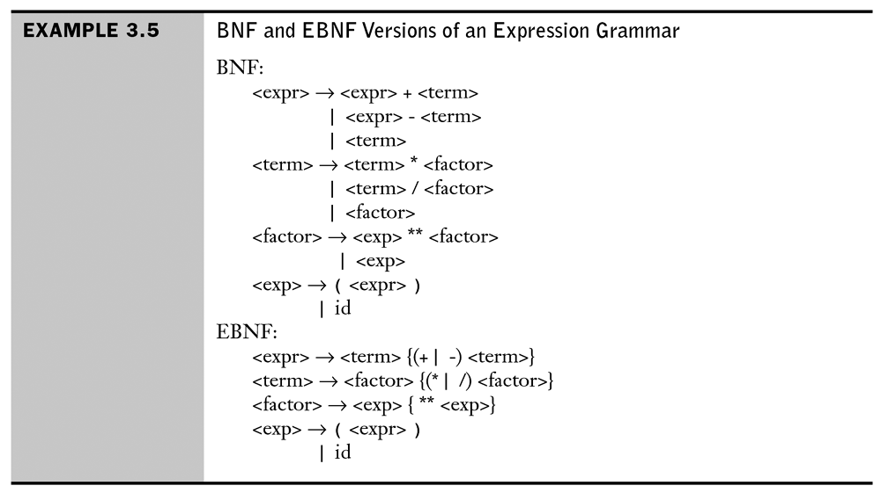
BNF vs EBNF

Slide 29

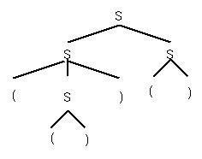
Derivations and Parse Trees
A derivation is a sequence of sentential forms starting from start symbol.
Derivation trees:
Grammar: B → 0B | 1B | 0 | 1
Derivation of 010:
B ⇒ 0B ⇒ 01B ⇒ 010
The parse tree follows from the derivation.
Derivations may not be unique
S → SS | (S) | ()
S ⇒ SS ⇒(S)S ⇒(())S ⇒(())()
S ⇒ SS ⇒ S() ⇒(S)() ⇒(())()
Different derivations yield the same parse tree
()
()

Slide 30
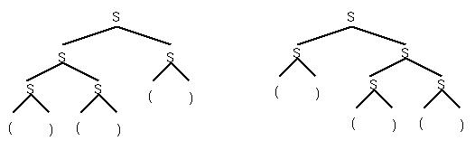
Ambiguity
Ambiguous grammars allow more than one parse tree for the same string. Example: ()()()
Each corresponds to a unique derivation:
  S ⇒ SS ⇒ SSS ⇒()SS ⇒()()S ⇒()()()
  S ⇒ SS ⇒ ()S ⇒()SS ⇒()()S ⇒()()()
A grammar is ambiguous if some sentence has 2 or more distinct parse trees.
Why is this important?
()
()
()
()
()
()

Slide 31
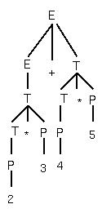
A typical grammar for expressions
E → E + T | T
T → T * P | P
P → i | ( E )
i → 1|2|3|4|5|6|7|8|9|0
Consider:
2*3+4*5
The value of
expression by this
Grammar is 26
Multiply 2 * 3 = 6
Multiply 4 * 5 = 20
Add 6 + 20 = 26

Slide 32
Other Expression Grammars
Grammar for 70:
E → E * T | T
T → T + P | P
P → i | ( E )
Grammar for 50:
E → E + T | E * T | T
T → i | ( E )
All 3 grammars generate exactly the same language, but each has a different meaning (i.e., expression value) for most expressions.
➔ Can’t use BNF to accurately represent semantics

Slide 33
Practice deriving strings top-down via sentential forms
Here is the grammar:
<p> ::= [<b>,<p>] | <b>
<b> ::= <c> | (<p>)
<c> ::= x | y | z
Show which of these are legal
instances of <p>.
  (x)
  [y]
  ([x,y])
  [(x),y]
  [(x),[y,x]]
  [(x),[{y},x]]

Slide 34
Semantic Modeling
A programming language must specify the meaning of its constructs:
  by themselves
  in conjunction with other language constructs
Finding a solution to the problem of defining language semantics has been much more difficult (and much less successful) than defining syntax.
Methods for formally specifying semantics:
  Grammatical models
  Operational models
  Axiomatic models
  Denotational models

Slide 35
Semantic Modeling Approaches
Grammatical models: add extensions to the BNF grammar for the language, which is used to extract additional info from the parse tree.
Operational models: define how programs in the language are executed on a virtual computer. Compare that to the actual execution on a real computer.
Axiomatic models: construct a formal logical proof to show that a program meets its specifications.
Denotational Models: mathematical representations are used to denote the meanings of language constructs.

Slide 36
Attribute Grammars
Basics
  Developed by Donald Knuth
  The basic idea is to associate a function with each node in the parse tree which gives the semantic content of the node.
Types of attributes
  Inherited – relate non-terminal values with non-terminals that are higher up in the tree.
  Synthesized – relate LHS non-terminal to values of the RHS non-terminals, which are passed up the tree.
Attribute grammars can be used to make semantic information available where needed in the parse tree.

Slide 37
Attributes for “value” of an expression
Consider the synthesized attributes for a grammar for arithmetic expressions:
Production Attribute
E → E+T value(E₁)= value(E₂)+ value(T)
E → T value(E) = value(T)
T → T*F value(T₁)= value(T₂)* value(F)
T → F value(T) = value(F)
F → I value(F) = value(I)
F → (E) value(F) = value(E)
Consider the attribute tree that gives the value of the expression:
2 + 4 x (1 + 2)

Slide 38
%{
#include <ctype.h>
%}
%token DIGIT
%%
line : expr ‘\n’ {printf("%d\n",$1);}
;
expr : expr ‘+’ term {$$ = $1 + $3; }
| term
;
term : term ‘*’ factor {$$ = $1 * $3; }
| factor
;
factor : ‘( ‘ expr ‘)’ {$$ = $2; }
| digit
;
%%
yylex() {
int c;
c = getchar();
if (isdigit(c)) {
yylval = c – ‘0’;
return DIGIT;
}
return c;
}

Slide 39
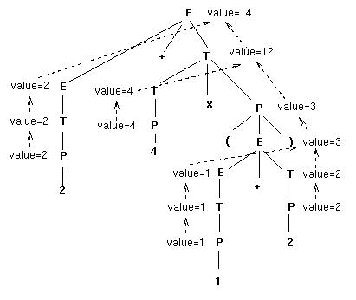
Attribute flow in a Parse Tree

Slide 40
Operational Semantics
Describe the meaning of a program by specifying the effects of running it on a (virtual) machine
Machine state changes as the program executes
The virtual machine may be a combination of the actual computer, operating system and a translator for that language
for(expr1; expr2; expr3)
{
. . .
}
The operational semantic representation of this loop makes its behavior much more clear:
expr1
loop: if !expr2 goto out
. . .
expr3;
goto loop

Slide 41
Denotational Semantics
Express the semantics of a programming language by a translation schema that associates a meaning (denotation) with each program in the language.
Meaning Functions – a denotational description of a programming language is given by a set of meaning functions associated with the constructs of the grammar.
M_{T} : T → D_{T}
Grammatical rule for binary numbers
  <bin_num> → '0'
        | '1'
        | <bin_num> '0'
        | <bin_num> '1'
A denotational definition is associated with each rule:
M_{bin}('0') = 0
M_{bin}('1') = 1
M_{bin}(<bin_num> '0') = 2 * M_{bin} (<bin_num>)
M_{bin}(<bin_num> '1') = 2 * (M_{bin} (<bin_num>) + 1)

Slide 42
The Meaning Function for Expression
M_{e}(<expr>, s) →
case <expr> of
<bin_num> => M_{bin}(<bin_num>, s)
<var> => if VARMAP(<var>,s) == undef then error
else VARMAP(<var>, s)
<binary_expr> =>
if(M_{e} (<binary_expr>.<left_expr>,s) == undef OR
M_{e} (<binary_expr>.<right_expr>,s)== undef)
then error;
else if M_{e}(<binary_expr>.<op>,s)==‘+’) then
M_{e} (<binary_expr>.<left_expr>,s) +
M_{e} (<binary_expr>.<right_expr>,s)
else
M_{e} (<binary_expr>.<left_expr>,s)*
M_{e} (<binary_expr>.<right_expr>,s)

Slide 43
Axiomatic Semantics
Views the definition of programming languages as a theory of the programs written in that language
More abstract than a denotational semantics approach – doesn’t try to determine what a program means, only what can be proven about its execution.
More practical than denotational – not interested in a formal model of the language, but interested in facts about the program – types of values they compute, will they halt, etc.
Motivating example: weakest preconditions
y = 3 * x + 1
x = y + 3 {x < 10} // the post condition
y + 3 < 10 and
y < 7
now:
y = 3 * x + 1
3 * x + 1 < 7
- 1 -1
3 * x < 6
{x < 2} is the weakest precondition …

